Slide 1
Data and Win Ratio Analysis in Soccer
University of Colorado Boulder

Slide 2
Problem Statement
A vast amount of data generated from sports
player skills
game results
seasonal performance
league management
The challenge for sports science
analyzing this data to gain a competitive edge
various techniques and statistical methods to extrapolate valuable insights
result predictions

Slide 3
Related Work
A Bayesian Approach to In-Game Win Probability in Soccer
Bayesian Model
predicts the result of future soccer matches
rank position
historical data

Slide 4
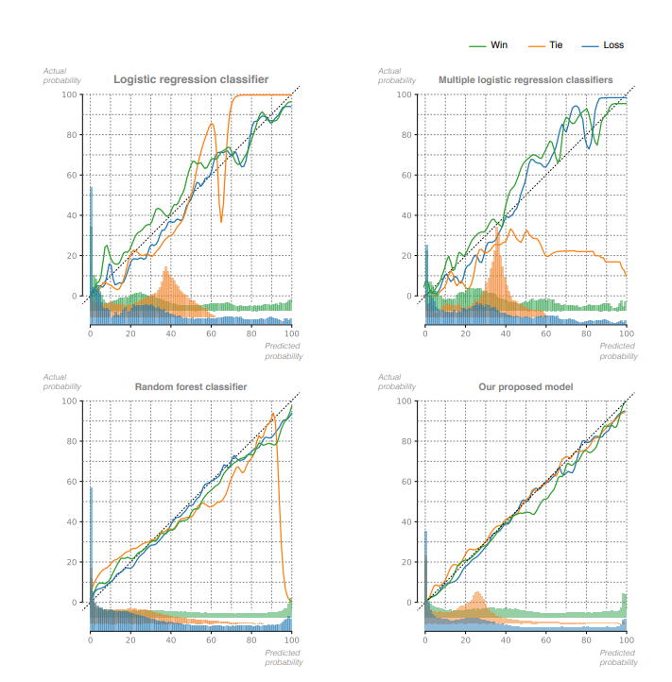
Bayesian model clearly outperforms the LR, mLR and RF models

Slide 5
Related Work
Application of the Apriori Algorithm in Soccer Games
Apriori algorithm
around the concept of "scoring opportunities“:
scoring opportunities
individual players
frequent player combinations.

Slide 6
Proposed Work
Tools
Python
SQL
Datasets
European Soccer Database
Tasks
Visualization
analyzing data
build result predictions
Techniques
Cluster analysis
Bayesian Model
Apriori algorithm

Slide 7
Evaluation
Model Validation
test it against data
the effectiveness
the accuracy
Prediction Accuracy
comparing with actual outcomes
win ratio of the outcome between the actual outcome
Improvements Over Time
progressive improvement in prediction over time
Comparison With Other Models:
assess effectiveness
compared with other similar models
standard statistical analysis

Slide 8
Timeline
Week 2 Project Proposal
Finished
Week 3 Checking Project
Finished
Week 4
Finished

Slide 9
TASK AND CHALLENGES
Exploratory data analysis

Slide 10
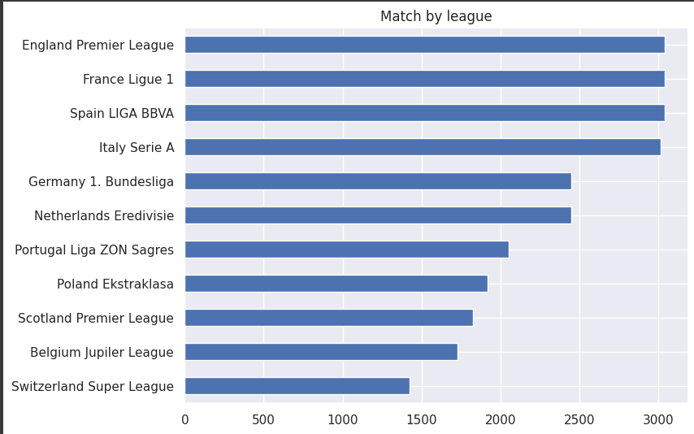
Exploratory data analysis
Matches by League

Slide 11
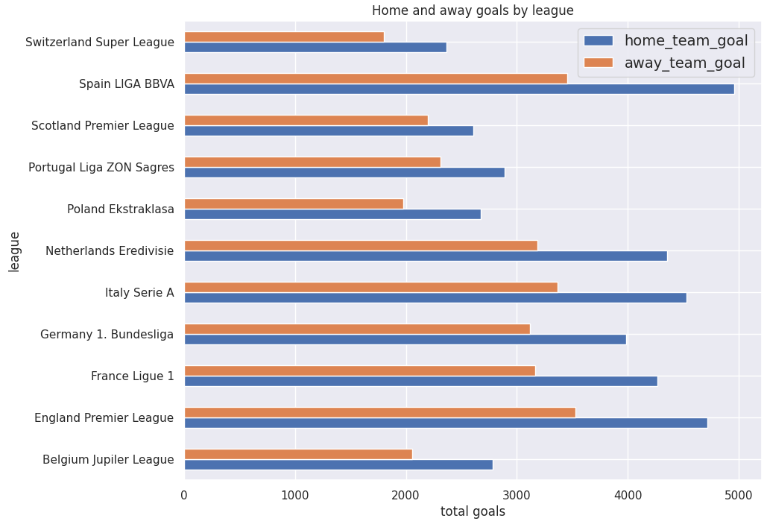
Exploratory data analysis
Matches by League

Slide 12
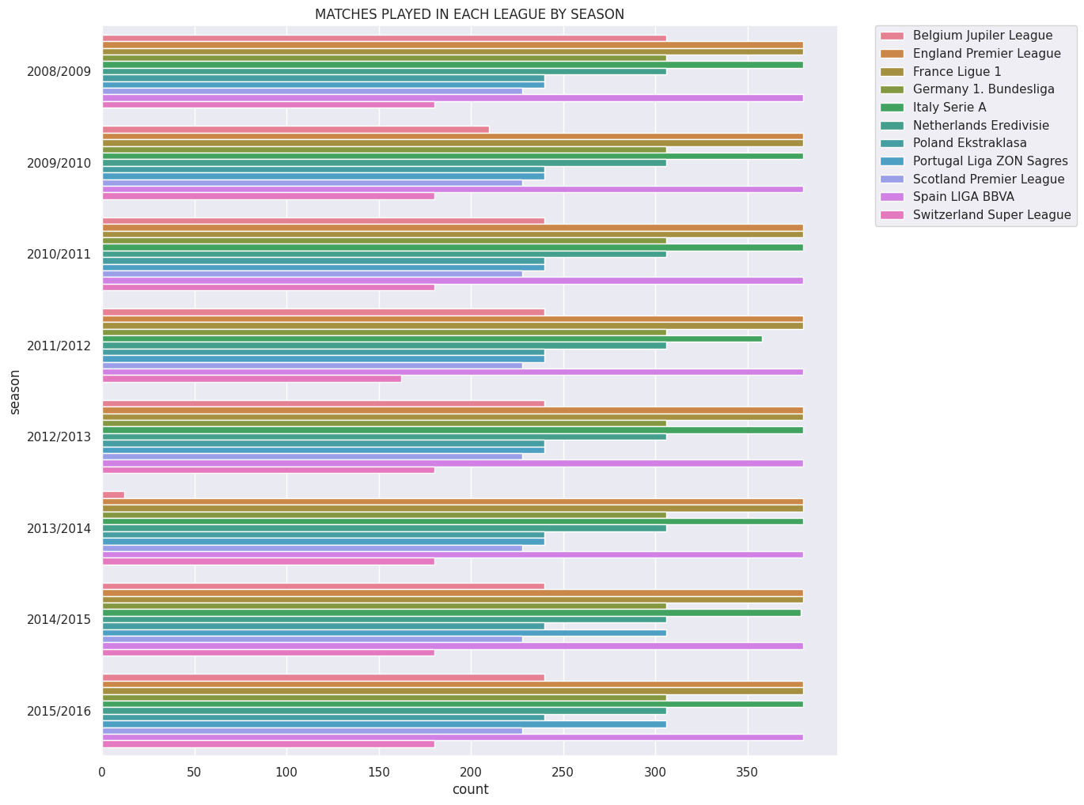
Exploratory data analysis
Matches by League

Slide 13
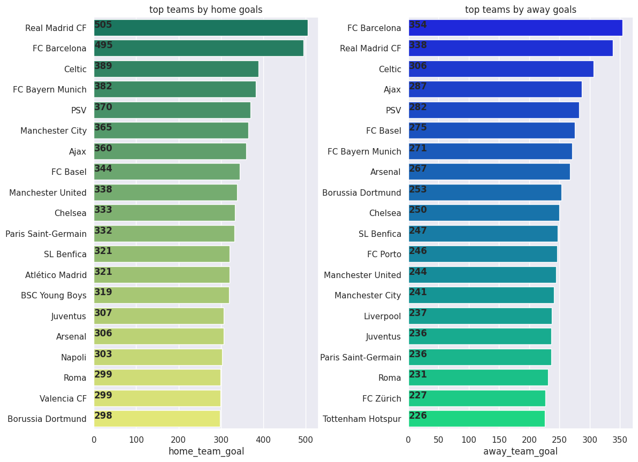
Exploratory data analysis
Matches by League

Slide 14
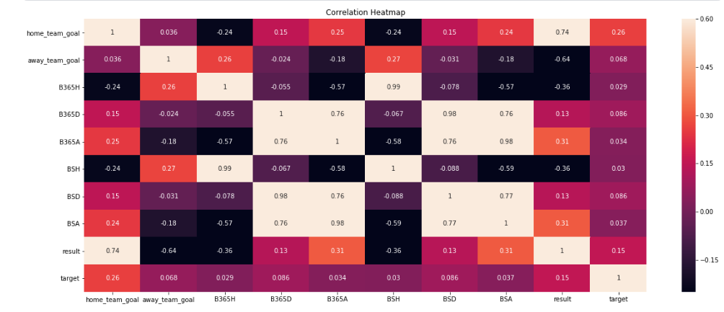
Exploratory data analysis
Correlation analysis

Slide 15

Bayesian data analysis
distribution of future goals:

Slide 16
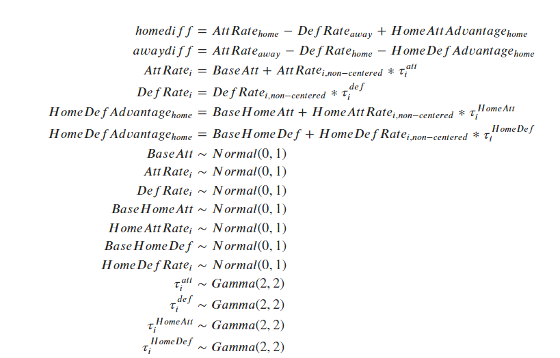
Bayesian data analysis
Likelihood:

Slide 17
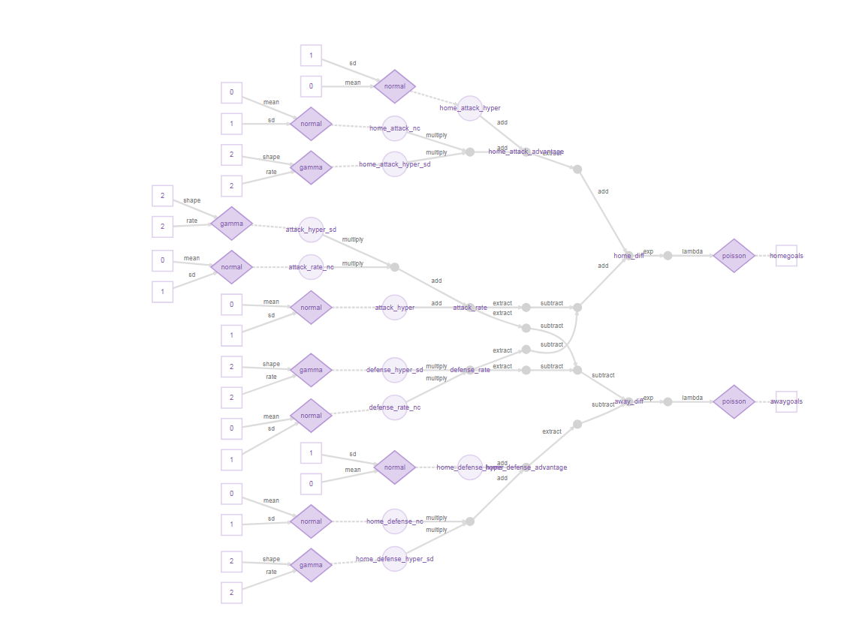
Bayesian model

Slide 18
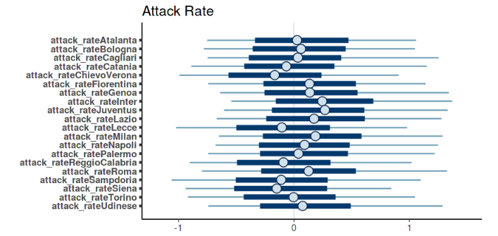
Evaluation and feature importance
base features

Slide 19
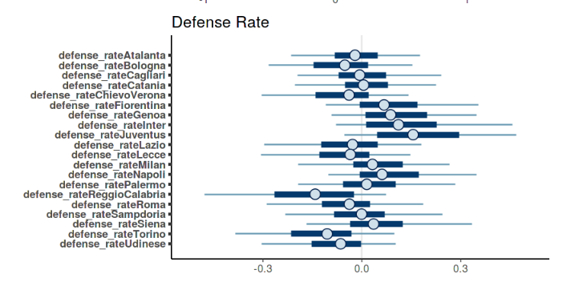
Evaluation and feature importance
base features

Slide 20
CONCLUSIONS
Bayesian model utilizes team-specific features and predicts the future number of goals scored
requires only a relatively small amount of data to learn effectively.
In the era of Big Data, where not all datasets are large, this technique offers a reliable way to create robust models
Bayesian multilevel modeling a powerful and valuable tool for sports analytics

